Slide 1

How Artificial Intelligence Can Forecast Zero-Day Vulnerabilities
By: Shanysse Alexander and Leon Bathersfield

Slide 2
Introduction
With the proliferation of new technology tools and increasing security threats, it becomes more and more difficult to detect and stop hacking attacks on networks. New technology has spread using IOT(Internet of Things) to complete simple functions to add convenience to IT. Many uses of IOT are in devices like smart home devices like security systems, locks and doors and Smart Car like predicting traffic, maintenance and remote updates for smart cars. Wearable health devices like Apple Watches, health monitors, smartphones, and commercial IOT like business automation, data analysis, and manufacturing are all linked to new uses of IOT.
This new tech will along security issues that will need to be protected. Using AI to predict possibilities that can arise in this field will greatly improve the security and predict issues before they occur. Zero-day attacks and vulnerabilities are attacks and loopholes that affect devices after release that are unknown to the product. If these Zero-Day vulnerabilities are unpredictable because they happen after a device/service is created, using AI to develop algorithms to close the loopholes will go farther than anything that can be done to prevent security threats.

Slide 3
Problem Statement
- Zero-day vulnerabilities pose a significant threat to new software, hardware, and firmware, as their existence remains unknown until product release, leaving them susceptible to exploitation.
- Leveraging AI in vulnerability detection can enhance product security by preemptively identifying and addressing vulnerabilities before release, facilitating smoother product launches.
- With the increasing prevalence of zero-day attacks, organizations must prioritize investment in AI-driven security solutions, incident response plans, and regular security assessments to safeguard their products and systems, maintain client trust, and foster a culture of security awareness among employees.

Slide 4

Purpose of Research
The purpose of researching AI forecasting of zero-day vulnerabilities is to mitigate the financial and reputational risks they pose to organizations. By leveraging AI's capabilities to anticipate and address these vulnerabilities, organizations can proactively enhance their cybersecurity posture and maintain customer trust. Integrating AI into vulnerability management processes facilitates faster threat response and fosters a culture of security awareness, ultimately strengthening overall cybersecurity resilience.

Slide 5
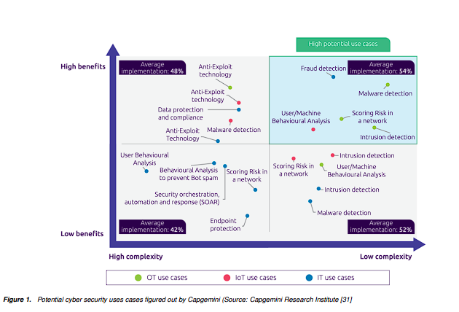
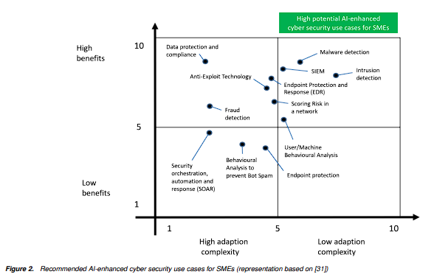
Case Study
Studies concluded by the Society of Imaging Science and Technology has evaluated the case for improving Cyber security defenses of small and medium sized companies. The study aims to determine if AI related security defenses would have a high impact potential to increase cyber security and protection level with only moderate effort. The Capgemini Research Institute organized 20 AI related cases based on cyber security into three categories: IT(Internet Technology), OT(Organizational Technology) and IoT(Internet of Things). Evaluation was based on seven cases: Malware Detection, Anti-Exploit Tech, Intrusion Detection, Endpoint Protection and Response(EDR), User/Machine Behavioral Analysis, Scoring Risk in a network, and Security Information and Event Management. Analysis of these data points are shown by the data in these categories based on Cyber Security use cases that could be used by Small/Medium sized companies. The study shows that AI based solutions to security in all versions of IT,OT, and IoT can be marginally to decisively increased in SME companies using AI to assist with Deep learning in a company environment to adapt to changes and protect systems.

Slide 6
Method 1
- The study assesses various machine and deep learning classifiers grouped into four categories, including Conventional Machine Learners and Simple Neural Networks with different layer configurations and epoch values.
- Different Python scripts and packages such as AdaBoostClassifier(), DecisionTreeClassifier(), and RandomForestClassifier() were utilized for testing purposes.
- Standardizing data before training machine learning models significantly improved accuracy and efficiency across different classifiers, with Random Forest emerging as the best classifier achieving 99.51% average accuracy, followed closely by Decision Tree and Simple Neural Networks with a single hidden layer.

Slide 7
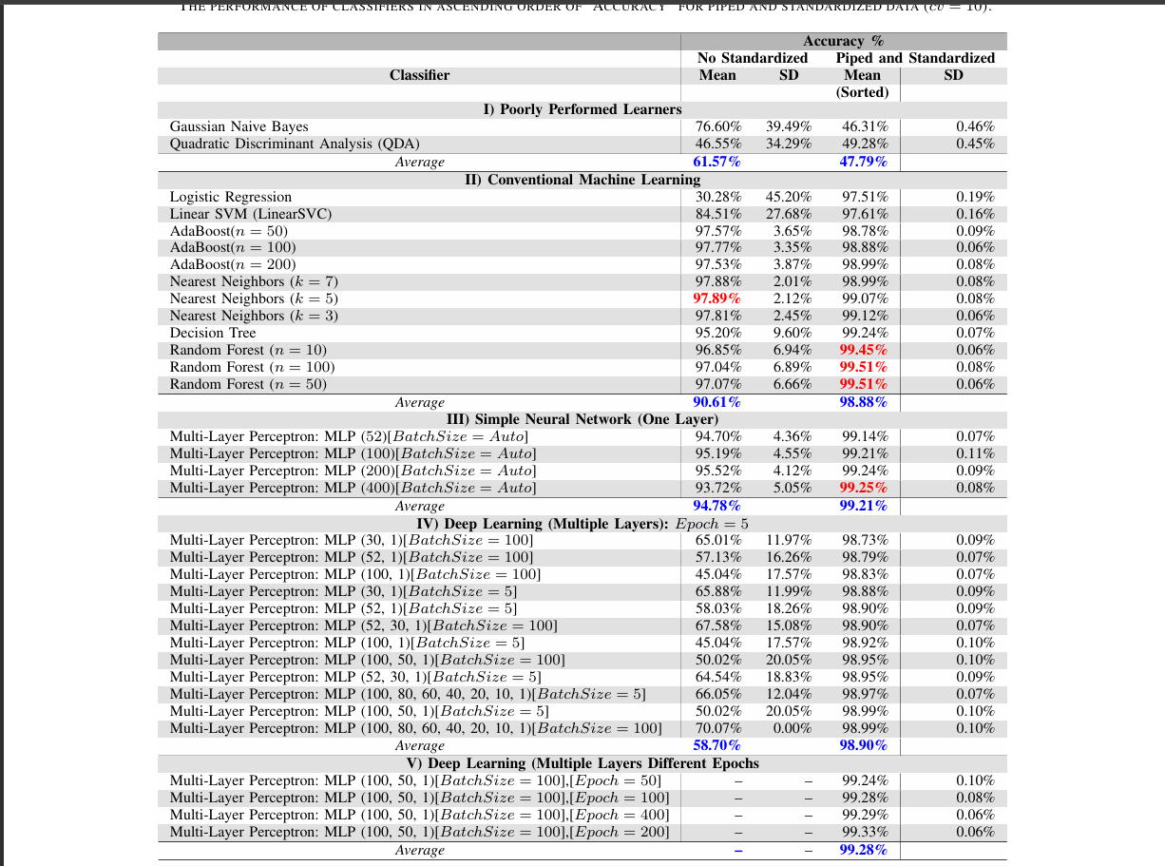
Method 1

Slide 8
Method 2
- The study utilizes deep learning techniques to detect zero-day Flash malware on the Adobe Flash platform, addressing the evolving threat landscape.
- Unlike previous methods, the approach abstracts both benign and malicious features, enabling adaptation to new threats and enhancing detection effectiveness.
- Through validation with Flash malware collected from real-world sources, the approach demonstrates high accuracy in identifying previously unknown threats, showcasing its potential for effective zero-day attack detection.

Slide 9
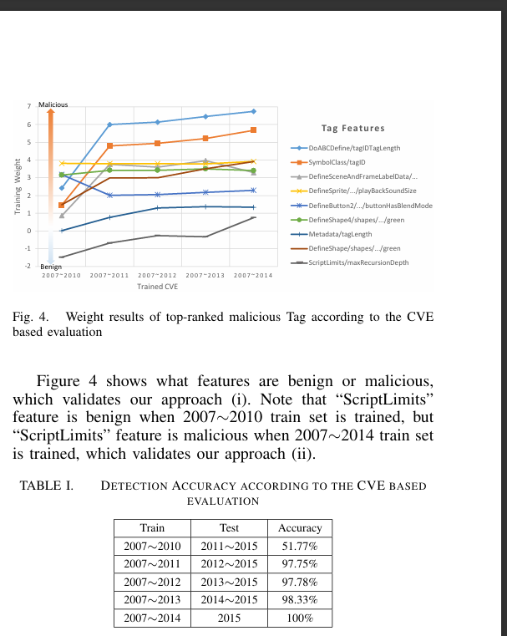
Method 2

Slide 10
Method 3
- The article introduces a Zero-Shot Learning (ZSL)-based methodology for evaluating machine learning based Network Intrusion Detection Systems (NIDSs) in identifying zero-day attacks.
- By eliminating the need for training data of all potential attack classes after deployment, the approach focuses on detecting new and unseen attack classes, showcasing its potential for zero-day attack detection.
- Evaluation metrics include Z-DR and overall accuracy, with analysis using the Wasserstein Distance to identify specific attack groups, highlighting challenges and opportunities for ML-based NIDSs in zero-day attack detection.

Slide 11
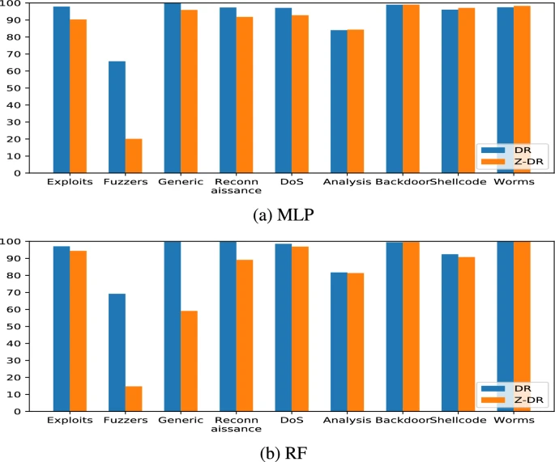
Method 3

Slide 12
Method 4
- The article explores two methods, Autoencoder and One-Class SVM, for effective zero-day attack detection, utilizing deep learning techniques.
- Autoencoder, employing an Artificial Neural Network (ANN), undergoes hyper-parameter optimization through random search, selecting architecture, epochs, and learning rate, mitigating the risk of over-fitted parameters.
- Results demonstrate Autoencoder's efficacy in detecting zero-day vulnerabilities across different categories, with One-Class SVM showing consistent detection accuracy for recognizable zero-day vulnerabilities but limited performance for complex ones.

Slide 13
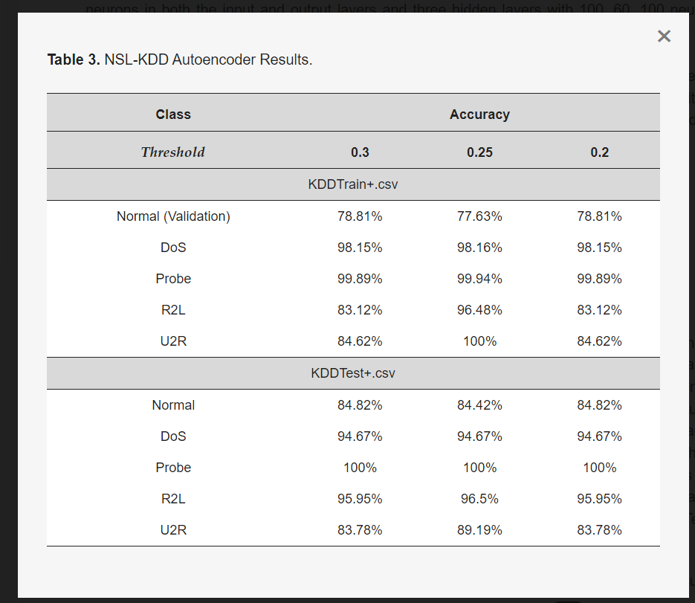
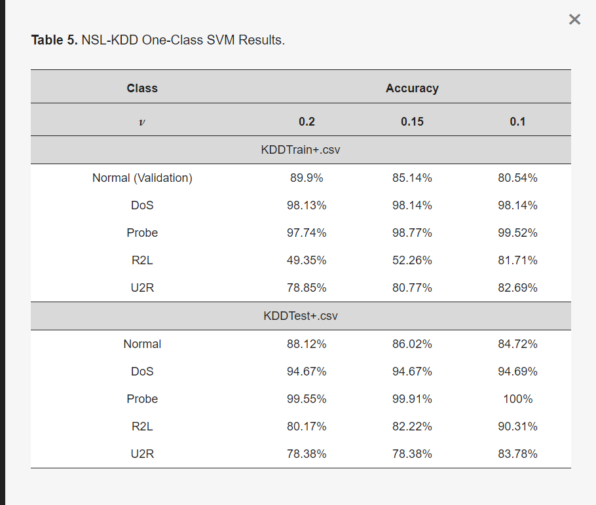
Method 4

Slide 14
Summary
The evolution of technology brings new challenges in network security, particularly concerning zero-day attacks, which require enhanced detection. These attacks, causing significant disruptions upon software release, requires the urgency for innovative solutions. Leveraging AI to proactively detect and mitigate potential threats represents a promising avenue for improving network security, especially during the increasing adoption of IoT devices across various sectors. Research into machine and deep learning classifiers, such as Autoencoder and One-Class SVM, showcases their potential to address the complexities of zero-day vulnerabilities, albeit requiring further refinement to fully safeguard against emerging threats.

Slide 15
References
Abri, F., Siami-Namini, S., Khanghah, M. A., Soltani, F. M., & Namin, A. S. (2019, November 21). The performance of machine and deep learning classifiers in detecting Zero-Day vulnerabilities. arXiv.org. https://arxiv.org/abs/1911.09586
Daniel Kant, Andreas Johannsen, "Evaluation of AI-based use cases for enhancing the cyber security defense of small and medium-sized companies (SMEs)" in Proc. IS&T Int’l. Symp. on Electronic Imaging: Mobile Devices and Multimedia: Enabling Technologies, Algorithms, and Applications, 2022, pp 387-1 - 387-8, https://doi.org/10.2352/EI.2022.34.3.MOBMU-387
Hindy, H., Atkinson, R., Tachtatzis, C., Colin, J., Bayne, E., & Bellekens, X. (2020). Utilising deep learning techniques for effective Zero-Day attack detection. Electronics, 9(10), 1684. https://doi.org/10.3390/electronics9101684
How automotive IOT and connected cars are used today. Built In. (n.d.-b). https://builtin.com/articles/iot-in-vehicles#:~:text=Connected%20cars%20are%20able%20to,enhance%20safety%20on%20the%20road.
Irjeas. (n.d.-b). https://www.irjeas.org/wp-content/uploads/admin/volume10/V10I2/IRJEAS04V10I204220622000005.pdf
Jung, W., Kim, S., Choi, S., & Cyber Security Research Center, KAIST. (n.d.). Deep learning for zero-day flash malware detection. Poster: Deep Learning for Zero-day Flash Malware Detection. https://www.covert.io/research-papers/deep-learning-security/Poster%20-%20Deep%20Learning%20for%20Zero-day%20Flash%20Malware%20Detection.pdf
Parrend, P., Navarro, J., Guigou, F., Deruyver, A., & Collet, P. (2018). Foundations and applications of artificial Intelligence for zero-day and multi-step attack detection. EURASIP Journal on Information Security, 2018(1). https://doi.org/10.1186/s13635-018-0074-y
Sarhan, M., Layeghy, S., Gallagher, M., & Portmann, M. (2023). From zero-shot machine learning to zero-day attack detection. International Journal of Information Security, 22(4), 947–959. https://doi.org/10.1007/s10207-023-00676-0

